Slide 1
From modules to qualifications – reshaping the languages curriculum at the Open University
Dr Uwe Baumann and Dr Elodie Vialleton
Reshaping Languages in Higher Education. July 2014

Slide 2
Languages at the Open University
Founded in 1991, first language course available in 1995
Chinese, French, German, Italian, Spanish, English Language Teaching
From beginners’ to degree level in French, German and Spanish
Qualifications: CertHE, DipHE, BA in Modern Languages
7750 students in this academic year
Integration of subject knowledge and language learning at all levels

Slide 3
External changes
Introduction of new fees in England (up to £9k)
Emphasis on value for money
Employability
Transparency of reporting performance
Key data sets
Student expectations – customers who expect high level and flexibility of service

Slide 4
Internal changes
Change in fees - £5k for 120 credits, different fee regimes in Scotland
Part-time students became eligible for student loans
Anticipated change in student behaviour
Transitional students in the system vs ‘new’ students
M-world – Q-world
Traditional focus was on individual modules
stronger focus on qualifications, structured pathways, retention, exam pass rates, completion

Slide 5
Languages curriculum design in M-world
Historically, our courses were developed one module at a time, from OU level 1 upwards, in French, then German, then Spanish (more were added later).
Each module was designed to be self-contained (with its own syllabus and learning outcomes).
There was some overlap between modules in a given language
The language progression was mapped inter alia against the CEFR…
… but the progression of culture content and skills wasn’t designed as systematically.
There was less coherence between languages, leading to differences in learning experience for students.
Notes:
It was fit for purpose for when it was designed
Old curriculum created from l1 upwards, each module a building block
Each module was self contained
Reference against CEFR
No focus on qualification
(although it worked with students doing modules sequentially)
Issues were bits in between
Progression of transferable skills wasn’t so systematic. Less coherence between languages.

Slide 6
The building blocks in M-world modules
Languages modules
Culture
Language
Study skills

Slide 7
The curriculum review process
A long-term project, started in September 2012
12 months to design a curriculum in 11 areas
12 further months to integrate them into a single framework
Gradual implementation will take about 10 years
All academics from the department were involved
Working groups formed to make recommendations for separate areas. Recommendations discussed and reviewed through comprehensive department-wide consultations.

Slide 8
Working groups
Phase 1: themes, language, language skills, intercultural communicative competence, wider skills
Phase 2: phonological competence, digital and information literacy, academic skills, employability and professional skills
Phase 3: bringing it all together into a single framework and implementing
Notes:
To check via jackie (hod and sec area on hood)

Slide 9
Background reference, frameworks and external environment reviewed
CEFR
OU levels framework
QAA benchmarks
Curriculum / modules from other UK languages departments
Language teaching textbooks / courses from language centres
OU and external digital literacy frameworks
OU and external professional skills frameworks
Theoretical approaches to Intercultural Communicative Competence and academic literacy

Slide 10
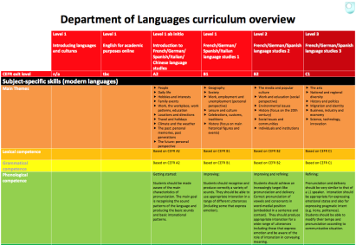
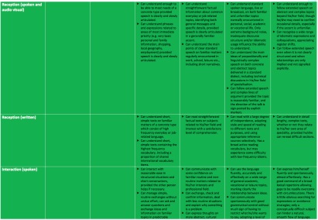
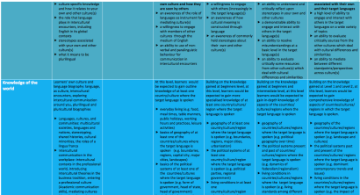
The outcome
A framework encompassing all languages and all levels (ab initio to BA)
Fixed principles ensure the systematic development of knowledge and skills through coherent progression
Principles also allow for culture- and language- specific differentiation, where appropriate
Notes:
What is constrained is the framework not the details
Culturally-appropriate differentiation
Say something that the overview is just for illustration

Slide 11
Subject-specific competences and skills
Language Studies curriculum
Grammatical competence
Lexical competence
Themes
Phonological competence
Intercultural communication competence
Language skills
Text types
Knowledge of the world
Notes:
For the visuall challenged, I tried to make the labels bigger

Slide 12
Non subject-specific skills
Language studies curriculum
Employability and professional skills
Academic skills
Digital and information literacy

Slide 13
All competences and skills
Language Studies curriculum
Grammatical competence
Lexical competence
Themes
Phonological competence
Intercultural communication competence
Language skills
Text types
Knowledge of the world
Language Studies curriculum
Employability and professional skills
Academic skills
Digital and information literacy
Notes:
Pick one or two and elaborate
ICC page + KoW= UB
+ academic or digital literacy

Slide 14
Example: Intercultural communicative competence
Notes:
Not needed, but it is a good illustration to have something to talk this through

Slide 15
Example: phonological competence
Notes:
Not needed, I agree

Slide 16
Qualification structure
STAGE 1
COMPULSORY
Exploring languages and cultures
Introduction to French studies
Introduction to German studies
Introduction to Spanish studies
Introduction to Italian studies
Introduction to Chinese studies
4x 30 credits
English for academic purposes
French studies 1
German studies 1
Spanish studies 1
Italian studies 1
STAGE 2
Worlds of English
French studies 2
German studies 2
Spanish studies 2
2x 60 credits
STAGE 3
The art of English
or
English grammar in context
French studies 3
German studies 3
Spanish studies 3
2x 60 credits

Slide 17
Challenges
Practical: keeping track of documentation; ensuring long-term implementation
Cultural: getting the whole department to ‘buy in’ and engage in cross-language work and negotiations
Professional: agree curriculum principles that apply across all parts of the curriculum
Professional: need for academics to deliver a wider set of skills (e.g. is a German academic competent in digital literacy?)
Pedagogical: making teaching space for non subject-specific skills without overloading students and without reducing the subject-specific study too much
Notes:
CEFR constrains part of the curriculum, a challenge because of the integration with content within one unit.
(implied going away from idea of teaching everything in the target language + inserting elements that are task-based to make it explicit

Slide 18
Opportunities
Refreshing the curriculum
Taking the time to discuss and rethink our whole pedagogical approach to Open Distance (Language) Learning
Enhancing collaborative learning
Comparing / discussing different teaching approaches and cultures across languages
Making the student experience more coherent across languages and across levels

Slide 19
Implementation within a module
Each unit to focus on a main theme, and to have a strong internal progression (5 sections = 5 weeks)
3 sections with a strong focus on language, cultural content and academic skills
1 section = online task-based work on ICC, with a collaborative task (possibly across languages)
1 section for revision and taking stock, reflecting on new skills
Notes:
This could be 300 hours or 600 hours of learning

Slide 20
Structure and progression of module units
Section 1 | Discover | grammatical comp. | Spoken and written reception | Knowledge of the world | Academic skills
 |  | lexical comp.
 |  |  | Spoken and written production
 |  | phonological comp.
Section 2 | Practise | grammatical comp. | Spoken and written reception | Knowledge of the world | Academic skills
 |  | lexical comp.
 |  |  | Spoken and written production
 |  | phonological comp.
Section 3 | Explore | grammatical comp. | Spoken and written reception | Knowledge of the world | Academic skills
 |  | lexical comp.
 |  |  | Spoken and written production | Intercultural comm. comp.
 |  | phonological comp.
Section 4 | Discuss |  | Spoken and written interaction | Intercultural comm. comp. | Digital and information literacy
 |  |  |  |  | Employability and professional skills
Section 5 | Reflect | grammatical comp. | Spoken and written reception + prod. | Intercultural comm. comp. | Digital and information literacy
 |  | lexical comp.
 |  |  |  |  | Employability and professional skills

Slide 21
Conclusions
Much of the content and skills were taught before, but what was required was
- a systematic approach for an entire curriculum,
- making the development of some skills explicit and - embedding them into the students’ learning.
In line with the institutional culture of long lead-in times for curriculum - a long term view is required. What we have now is a roadmap. The implementation will take years.
Notes:
CCL
We systematised and made explicit what we were already doing . It was almost all there before.
It takes a long term view, no quick fixes. The implementation will take 10 years. It’s a roadmap.
Anything else?

Slide 22
Many thanks uwe.baumann@open.ac.uk elodie.vialleton@open.ac.uk Faculty of Education and Language Studies The Open University Walton Hall Milton Keynes MK7 6AA
www.open.ac.uk

